Slide 1
Neural Networks part 2
Jurafsky and Martin Chapters 7 and 9

Slide 2
Review: Feed-Forward Neural Network
The simplest kind of is the Feed-Forward Neural Network
Multilayer network, all units are usually fully-connected, and no cycles.
The outputs from each layer are passed to units in the next higher layer, and no outputs are passed back to lower layers.
Layer 2 (output layer)
Layer 1 (hidden layer)
Layer 0 (input layer)
Notes:
We’ll introduce networks with cycles, called recurrent neural networks Later. For historical reasons multilayer networks, especially feedforward networks, are sometimes called multi-layer perceptrons (or MLPs); this is a technical misnomer, since the units in modern multilayer networks aren’t perceptrons (perceptrons are purely linear, but modern networks are made up of units with non-linearities like sigmoids), but at some point the name stuck.
The core of the neural network is the hidden layer formed of hidden units, each of which is a neural unit, taking a weighted sum of its inputs and then applying a non-linearity. In the standard architecture, each layer is fully-connected, meaning that each unit in each layer takes as input the outputs from all the units in the previous layer, and there is a link between every pair of units from two adjacent layers. Thus each hidden unit sums over all the input units.

Slide 3
Andrew Ng

Slide 4
Review: Feed-Forward Neural Network
A single hidden unit has parameters w (the weight vector) and b (the bias scalar).
We represent the parameters for the entire hidden layer by combining the weight vector w_{i} and bias b_{i} for each unit i into a single weight matrix W and a single bias vector b for the whole layer.
Notes:
Each element Wi j of the weight matrix W represents the weight of the connection from the ith input unit xi to the jth hidden unit hj.

Slide 5
Review: Feed-Forward Neural Network
The advantage of using a single matrix W for the weights of the entire layer is the hidden layer computation can be done efficiently with simple matrix operations.
The computation has three steps:
1. multiplying the weight matrix by the input vector x, 2. adding the bias vector b, and 3. applying the activation function g (such as Sigmoid)
The output of the hidden layer, the vector h, is thus the following, using the sigmoid function σ:
h = σ(Wx+b)
Notes:
Notice that we’re applying the σ function here to a vector, while previously it was applied to a scalar. We’re thus allowing σ(·), and indeed any activation function g(·), to apply to a vector element-wise, so g[z1,z2,z3] = [g(z1),g(z2),g(z3)].

Slide 6
Review: Feed-Forward Neural Network
Like the hidden layer, the output layer has a weight matrix U. Its weight matrix is multiplied by its input vector (h) to produce the intermediate output z.
z=Uh
Notes:
Each element Wi j of the weight matrix W represents the weight of the connection from the ith input unit xi to the jth hidden unit hj.

Slide 7
Review: Feed-Forward Neural Network
Here are the final equations for a feedforward network with a single hidden layer, which takes an input vector x, outputs a probability distribution y, and is parameterized by weight matrices W and U and a bias vector b:
h = σ(Wx+b) z = Uh y = softmax(z)
Like with logistic regression, softmax normalizes the output and turns it into a probability distribution.
Notes:
Notice that we’re applying the σ function here to a vector, while previously it was applied to a scalar. We’re thus allowing σ(·), and indeed any activation function g(·), to apply to a vector element-wise, so g[z1,z2,z3] = [g(z1),g(z2),g(z3)].

Slide 8
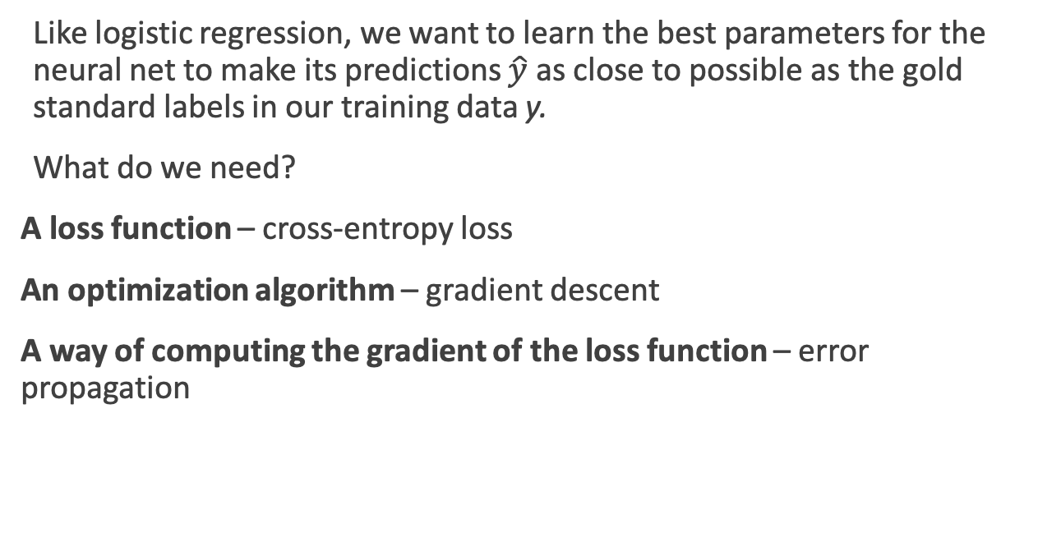
Training Neural Nets
Like logistic regression, we want to learn the best parameters for the neural net to make its predictions $\hat{y}$ as close to possible as the gold standard labels in our training data y.
What do we need?
A loss function – cross-entropy loss
An optimization algorithm – gradient descent
A way of computing the gradient of the loss function – error propagation
Notes:
gradient descent requires knowing the gradient of the loss function, the vector that contains the partial derivative of the loss function with respect to each of the parameters. Here is one part where learning for neural networks is more complex than for logistic logistic regression. In logistic regression, for each observation we could directly compute the derivative of the loss function with respect to an individual w or b. But for neural networks, with millions of parameters in many layers, it’s much harder to see how to compute the partial derivative of some weight in layer 1 when the loss is attached to some much later layer. How do we partial out the loss over all those intermediate layers?
The answer is the algorithm called error backpropagation or reverse differentiation.

Slide 9
Cross-Entropy Loss
If the neural network is a binary classifier with a sigmoid at the final layer, the loss function is exactly the same as we saw in logistic regression:
Notes:
K in the denominator is the number of classes.

Slide 10
Cross-Entropy Loss
If the neural network is a binary classifier with a sigmoid at the final layer, the loss function is exactly the same as we saw in logistic regression:
For multinomial classification
If there is only one correct answer, where the truth is y_{i}=1, then this simplifies to be
Plugging into softmax:
Notes:
K in the denominator is the number of classes.

Slide 11
Computing the gradient
Logistic regression can be thought of as a network with just one weight layer and a sigmoid output. In that case the gradient is:
But these derivatives only give correct updates for the last weight layer! For deeper networks, computing the gradients requires looking back through all the earlier layers in the network, even though the loss is only computed with respect to the output of the network.

Slide 12
Computing the gradient
Logistic regression can be thought of as a network with just one weight layer and a sigmoid output. In that case the gradient is:
But these derivatives only give correct updates for the last weight layer! For deeper networks, computing the gradients requires looking back through all the earlier layers in the network, even though the loss is only computed with respect to the output of the network.
Solution: error backpropagation algorithm

Slide 13
Computation Graphs
Although backpropagation was invented for neural nets, it is related to general procedure called backward differentiation, which depends on the notion of computation graphs.
A computation graph represents the process of computing a mathematical expression. The computation is broken down into separate operations. Each operation is a node in a graph.
L(a, b, c) = c(a + 2b)
d = 2∗b
e = a+d
L = c∗e
Notes:
If we make each of the component addition and multiplication operations explicit, and add names (d and e) for the intermediate outputs, the resulting series of computations is as shown on the righ.

Slide 14
Forward pass
L(a, b, c) = c(a + 2b)
d = 2∗b
e = a+d
L = c∗e
inputs a = 3, b = 1, c = −2,
Notes:
We can now represent this as a graph, with nodes for each operation, and directed edges showing the outputs from each operation as the inputs to the next, The simplest use of computation graphs is to compute the value of the function with some given inputs. For inputs a = 3, b = 1, c = −2, and we’ve shown the result of the forward pass to compute the result L(3, 1, −2) = 10. In the forward pass of a computation graph, we apply each operation left to right, passing the outputs of each computation as the input to the next node.

Slide 15
Backward differentiation
The importance of the computation graph comes from the backward pass, which is used to compute the derivatives that we’ll need for the weight update.
How do we compute the derivative of our output function L with respect to the input variables a, b, and c?
Backwards differentiation uses the chain rule from calculus.
Notes:
The importance of the computation graph comes from the backward pass, which is used to compute the derivatives that we’ll need for the weight update. In this example our goal is to compute the derivative of the output function L with respect to each of the input variables, i.e., ∂L/∂a ∂L/∂b , and
∂L/∂c .
The derivative ∂L/∂a , tells us how much a small change in a affects L.

Slide 16
Chain rule
For a composite function f(x) = u(v(x)), the derivative of f(x) is:
Similarly for, f(x) = u(v(w(x))), the derivative of f(x) is:
Notes:
Suppose we are computing the derivative of a composite function f (x) = u(v(x)). The derivative of f (x) is the derivative of u(x) with respect to v(x) times the derivative of v(x) with respect to x.

Slide 17
Notes:
Let’s now compute the 3 derivatives we need. Since in the computation graph L = ce, we can directly compute the derivative ∂L/∂c For the other two, we’ll need to use the chain rule. thus requires five intermediate derivatives. the derivative of a sum is the sum of the derivatives.

Slide 18
Notes:
Let’s now compute the 3 derivatives we need. Since in the computation graph L = ce, we can directly compute the derivative ∂L/∂c For the other two, we’ll need to use the chain rule. thus requires five intermediate derivatives. the derivative of a sum is the sum of the derivatives.

Slide 19
Notes:
Let’s now compute the 3 derivatives we need. Since in the computation graph L = ce, we can directly compute the derivative ∂L/∂c For the other two, we’ll need to use the chain rule. thus requires five intermediate derivatives. the derivative of a sum is the sum of the derivatives.

Slide 20
Backward pass
Notes:
In the backward pass, we compute each of these partials along each edge of the graph from right to left, multiplying the necessary partials to result in the final derivative we need. Thus we begin by annotating the final node with ∂ L /∂ L = 1. Moving to the ∂L left, we then compute ∂ L/∂ c and ∂ L/∂ e , and so on, until we have annotated the graph all the way to the input variables. The forward pass conveniently already will have computed the values of the forward intermediate variables we need (like d and e) to compute these derivatives. In this figure, At each node we need to compute the local partial derivative with respect to the parent, multiply it by the partial derivative that is being passed down from the parent, and then pass it to the child.

Slide 21
Computation Graph for a NN
Notes:
This shows a sample computation graph for a 2-layer neural network with layers of sizen0 = 2, n1 = 2, and n2 = 1. Assuming binary classification and hence using a sigmoid output unit for simplicity. The function that the computation graph is computing is: given by these equations in the lower right.
he weights that need updating (those for which we need to know the partial derivative of the loss function) are shown in orange. In order to do the backward pass, we’ll need to know the derivatives of all the functions in the graph. The derivative of the sigmoid σ :
dσ(z)/dz = σ(z)(1−σ(z))

Slide 22
Neural Language Models

Slide 23
Language Models
Estimate the probability of a sentence consisting of word sequence w_{1:n}
We need to estimate the probability of P(w_{i+1}|w_{k-i:i}) from a large corpus.

Slide 24
Neural Language Models
Neural Language models have several advantages over n-gram LMs:
1. They don’t need smoothing
2. They can handle much longer histories.
3. They can generalize over contexts of similar words.
4. Neural LMs tend to have much higher predictive accuracy than n-gram LMs.
Disadvantage: slower to train than traditional n-gram LMs

Slide 25
Neural LMs
In neural LMs, the prior context is represented by embeddings. This allows neural LMs to generalize better than n-gram LMs.
Imagine in training we have seen
I have to make sure when I get home to feed the cat.
But we’ve never seen “feed the dog” in training. If in the test set, we want to predict the next word after
I forgot when I got home to feed the ____
An n-gram LM will only predict cat, but a neural LM will know that the embeddings for cat and dog are similar.
Notes:
In neural language models, the prior context is represented by embeddings of the previous words. Representing the prior context as embeddings, rather than by ex- act words as used in n-gram language models, allows neural language models to generalize to unseen data much better than n-gram language models. For example, suppose we’ve seen this sentence in training:
Take an input and time t, represent some number of previous words (w_{t-1}, w_{t-2,} w_{t-3}), and output a probability distribution over the next word. P(w_{t} | w_{t-1}, w_{t-2,} w_{t-3}).

Slide 26
Neural LMs (Bengio et al 2003)
Associate each word in the vocabulary with a vector-representation, thereby creating a notion of similarity between words.
Express the joint probability function of a word sequence in terms of the word vectors for the words in that sequence.
Simultaneously learn the word vectors and the parameters of the function.
The word vectors are low-dimensional (d=30 to d=100) dense vectors, like we’ve seen before.
The probability function is expressed the product of conditional probabilities of the next word given the previous word, using a multi-layer, feed forward neural network.

Slide 27
Neural LMs
The input to the neural network is a k-gram of words w_{1:k}.
The output is a probability distribution over the next word.
The k context words are treated as a word window. Each word is associated with an embedding vector:
The input vector x just concatenates v(w) for each of the k words:

Slide 28
Neural LMs
The input x is fed into a neural network with 1 or more hidden layers:
Notes:
V is a finite vocabulary, including the unique symbols U for unknown words, <s> for sentence initial padding, and </s> for end-of-sequence marking. e vocabulary size, jV j, ranges between 10,000–1,000,000 words, with the common sizes revolving around 70,000.

Slide 30
Training
The training examples are simply word k-grams from the corpus
The identities of the first k+1 words are used as features, and the last word is used as the target label for the classification.
Conceptually, the model is trained using cross-entropy loss.
Working with cross entropy loss works very well, but requires the use of a costly softmax operation which can be prohibitive for very large vocabularies, we we often use alternative loss functions or approximations.
Notes:
Large output spaces Working with neural probabilistic language models with large output spaces (i.e., efficiently computing the softmax over the vocabulary) can be prohibitive both at training time and at test time. Dealing with large output spaces efficiently is an active research question. Some of the existing solutions are as follows.
Hierarchical softmax [Morin and Bengio, 2005] allows to compute the probability of a single word in O.log jV j/ time rather than O.jV j/. is is achieved by structuring the softmax computation as tree traversal, and the probability of each word as the product of branch selection decisions. Assuming one is interested in the probability of a single word (rather than getting the distribution over all words) this approach provides clear benefits in both training and testing time. Self-normalizing aproaches, such as noise-contrastive estimation (NCE) [Mnih and Teh, 2012, Vaswani et al., 2013] or adding normalizing term to the training objective [Devlin et al., 2014]. e NCE approach improves training time performance by replacing the cross-entropy objective with a collection of binary classification problems, requiring the evaluation of the assigned scores for k random words rather than the entire vocabulary. It also improves test-time prediction by pushing the model toward producing “approximately normalized” exponentiated scores, making the model score for a word a good substitute for its probability. e normalization term approach of Devlin et al. [2014] similarly improves test time efficiency by adding a term to the training objective that encourages the exponentiated model scores to sum to one, making the explicit summation at test time unnecessary (the approach does not improve training time efficiency). Sampling Approaches approximate the training-time softmax over a smaller subset of the vocabu- lary [Jean et al., 2015].
A good review and comparison of these and other techniques for dealing with large output vocabularies is available in Chen et al. [2016].
An orthogonal line of work is attempting to sidestep the problem by working at the char- acters level rather than words level.

Slide 31
Training
The training examples are simply word k-grams from the corpus
The identities of the first k+1 words are used as features, and the last word is used as the target label for the classification.
Conceptually, the model is trained using cross-entropy loss.
Notes:
Large output spaces Working with neural probabilistic language models with large output spaces (i.e., efficiently computing the softmax over the vocabulary) can be prohibitive both at training time and at test time. Dealing with large output spaces efficiently is an active research question. Some of the existing solutions are as follows.
Hierarchical softmax [Morin and Bengio, 2005] allows to compute the probability of a single word in O.log jV j/ time rather than O.jV j/. is is achieved by structuring the softmax computation as tree traversal, and the probability of each word as the product of branch selection decisions. Assuming one is interested in the probability of a single word (rather than getting the distribution over all words) this approach provides clear benefits in both training and testing time. Self-normalizing aproaches, such as noise-contrastive estimation (NCE) [Mnih and Teh, 2012, Vaswani et al., 2013] or adding normalizing term to the training objective [Devlin et al., 2014]. e NCE approach improves training time performance by replacing the cross-entropy objective with a collection of binary classification problems, requiring the evaluation of the assigned scores for k random words rather than the entire vocabulary. It also improves test-time prediction by pushing the model toward producing “approximately normalized” exponentiated scores, making the model score for a word a good substitute for its probability. e normalization term approach of Devlin et al. [2014] similarly improves test time efficiency by adding a term to the training objective that encourages the exponentiated model scores to sum to one, making the explicit summation at test time unnecessary (the approach does not improve training time efficiency). Sampling Approaches approximate the training-time softmax over a smaller subset of the vocabu- lary [Jean et al., 2015].
A good review and comparison of these and other techniques for dealing with large output vocabularies is available in Chen et al. [2016].
An orthogonal line of work is attempting to sidestep the problem by working at the char- acters level rather than words level.

Slide 32
Advantages of NN LMs
Better results. They achieve better preplexity scores than SOTA n-gram LMs.
Larger N. NN LMs can scale to much larger orders of n. This is achievable because parameters are associated only with individual words, and not with n-grams.
They generalize across contexts. For example, by observing that the words blue, green, red, black, etc. appear in similar contexts, the model will be able to assign a reasonable score to the green car even though it never observed in training, because it did observe blue car and red car.
A by-product of training are word embeddings!
Notes:
Language models can be trained on raw text: for training a k-order language model one just needs to extract .k C 1/grams from running text, and treat the .k C 1/th word as the supervision signal. us, we can generate practically unlimited training data for them.

Slide 33
Language Modeling
Goal: Learn a function that returns the joint probability
Primary difficulty:
There are too many parameters to accurately estimate. This is sometimes called the “curse of dimensionality”
In n-gram-based models we fail to generalize to related words / word sequences that we have observed.

Slide 34
Curse of dimensionality / sparse statistics
Suppose we want a joint distribution over 10 words. Suppose we have a vocabulary of size 100,000.
100,000¹⁰ =10⁵⁰ parameters
This is too high to estimate from data.

Slide 35
Chain rule
In LMs we user chain rule to get the conditional probability of the next word in the sequence given all of the previous words:
$P(w_{1}w_{2}w_{3}$…$w_{t})= \prod_{t=1}^{T}{P(w_{t}|}w_{1}$…$w_{t−1})$
What assumption do we make in n-gram LMs to simplify this?
The probability of the next word only depends on the previous n-1 words.
A small n makes it easier for us to get an estimate of the probability from data.

Slide 36
Probability tables
We construct tables to look up the probability of seeing a word given a history.
The tables only store observed sequences.
What happens when we have a new (unseen) combination of n words?
curse of | P(w_{t} | w_{t-n} … w_{t-1})
dimensionality
azure
knowledge
oak
Notes:
“Stupid” multinomial distributions == table lookup.

Slide 37
Unseen sequences
What happens when we have a new (unseen) combination of n words?
Back-off
Smoothing / interpolation
We are basically just stitching together short sequences of observed words.

Slide 38
Alternate idea
Let’s try generalizing.
Intuition: Take a sentence like
The cat is walking in the bedroom
And use it when we assign probabilities to similar sentences like
The dog is running around the room
Notes:
Draw vectors under the words.
Write out: sim(cat, dog)

Slide 39
A Neural Probabilistic LM
Bengio et al NIPS 2003
Use a vector space model where the words are vectors with real values ℝ^{m}. m=30, 60, 100. This gives a way to compute word similarity.
Define a function that returns a joint probability of words in a sequence based on a sequence of these vectors.
Simultaneously learn the word representations and the probability function from data.
Seeing one of the cat/dog sentences allows them to increase the probability for that sentence and its combinatorial # of “neighbor” sentences in vector space.

Slide 40
A Neural Probabilistic LM
Given:
A training set w₁ … w_{t} where w_{t} ∈V
Learn:
f(w₁ … w_{t}) = P(w_{t}|w₁ … w_{t-1})
Subject to giving a high probability to an unseen text/dev set (e.g. minimizing the perplexity)
Constraint:
Create a proper probability distribution (e.g. sums to 1) so that we can take the product of conditional probabilities to get the joint probability of a sentence

Slide 41
A Neural Probabilistic LM
Create a mapping function C from any word in V onto ℝ^{M}. Store this in a V-by-M matrix. Initialize it with singular value decomposition (SVD).
The neural architecture: a function g maps sequence of word vectors onto a probability distribution over the vocabulary V
g(C(w_{t-n}) … C(w_{t-1})) = P(w_{t}|w_{t-n} … w_{t-1})
Notes:
g is implemented with a feed forward or recurrent neural network, trained with stochastic gradient descent. Softmax is used in the output layer.

Slide 42
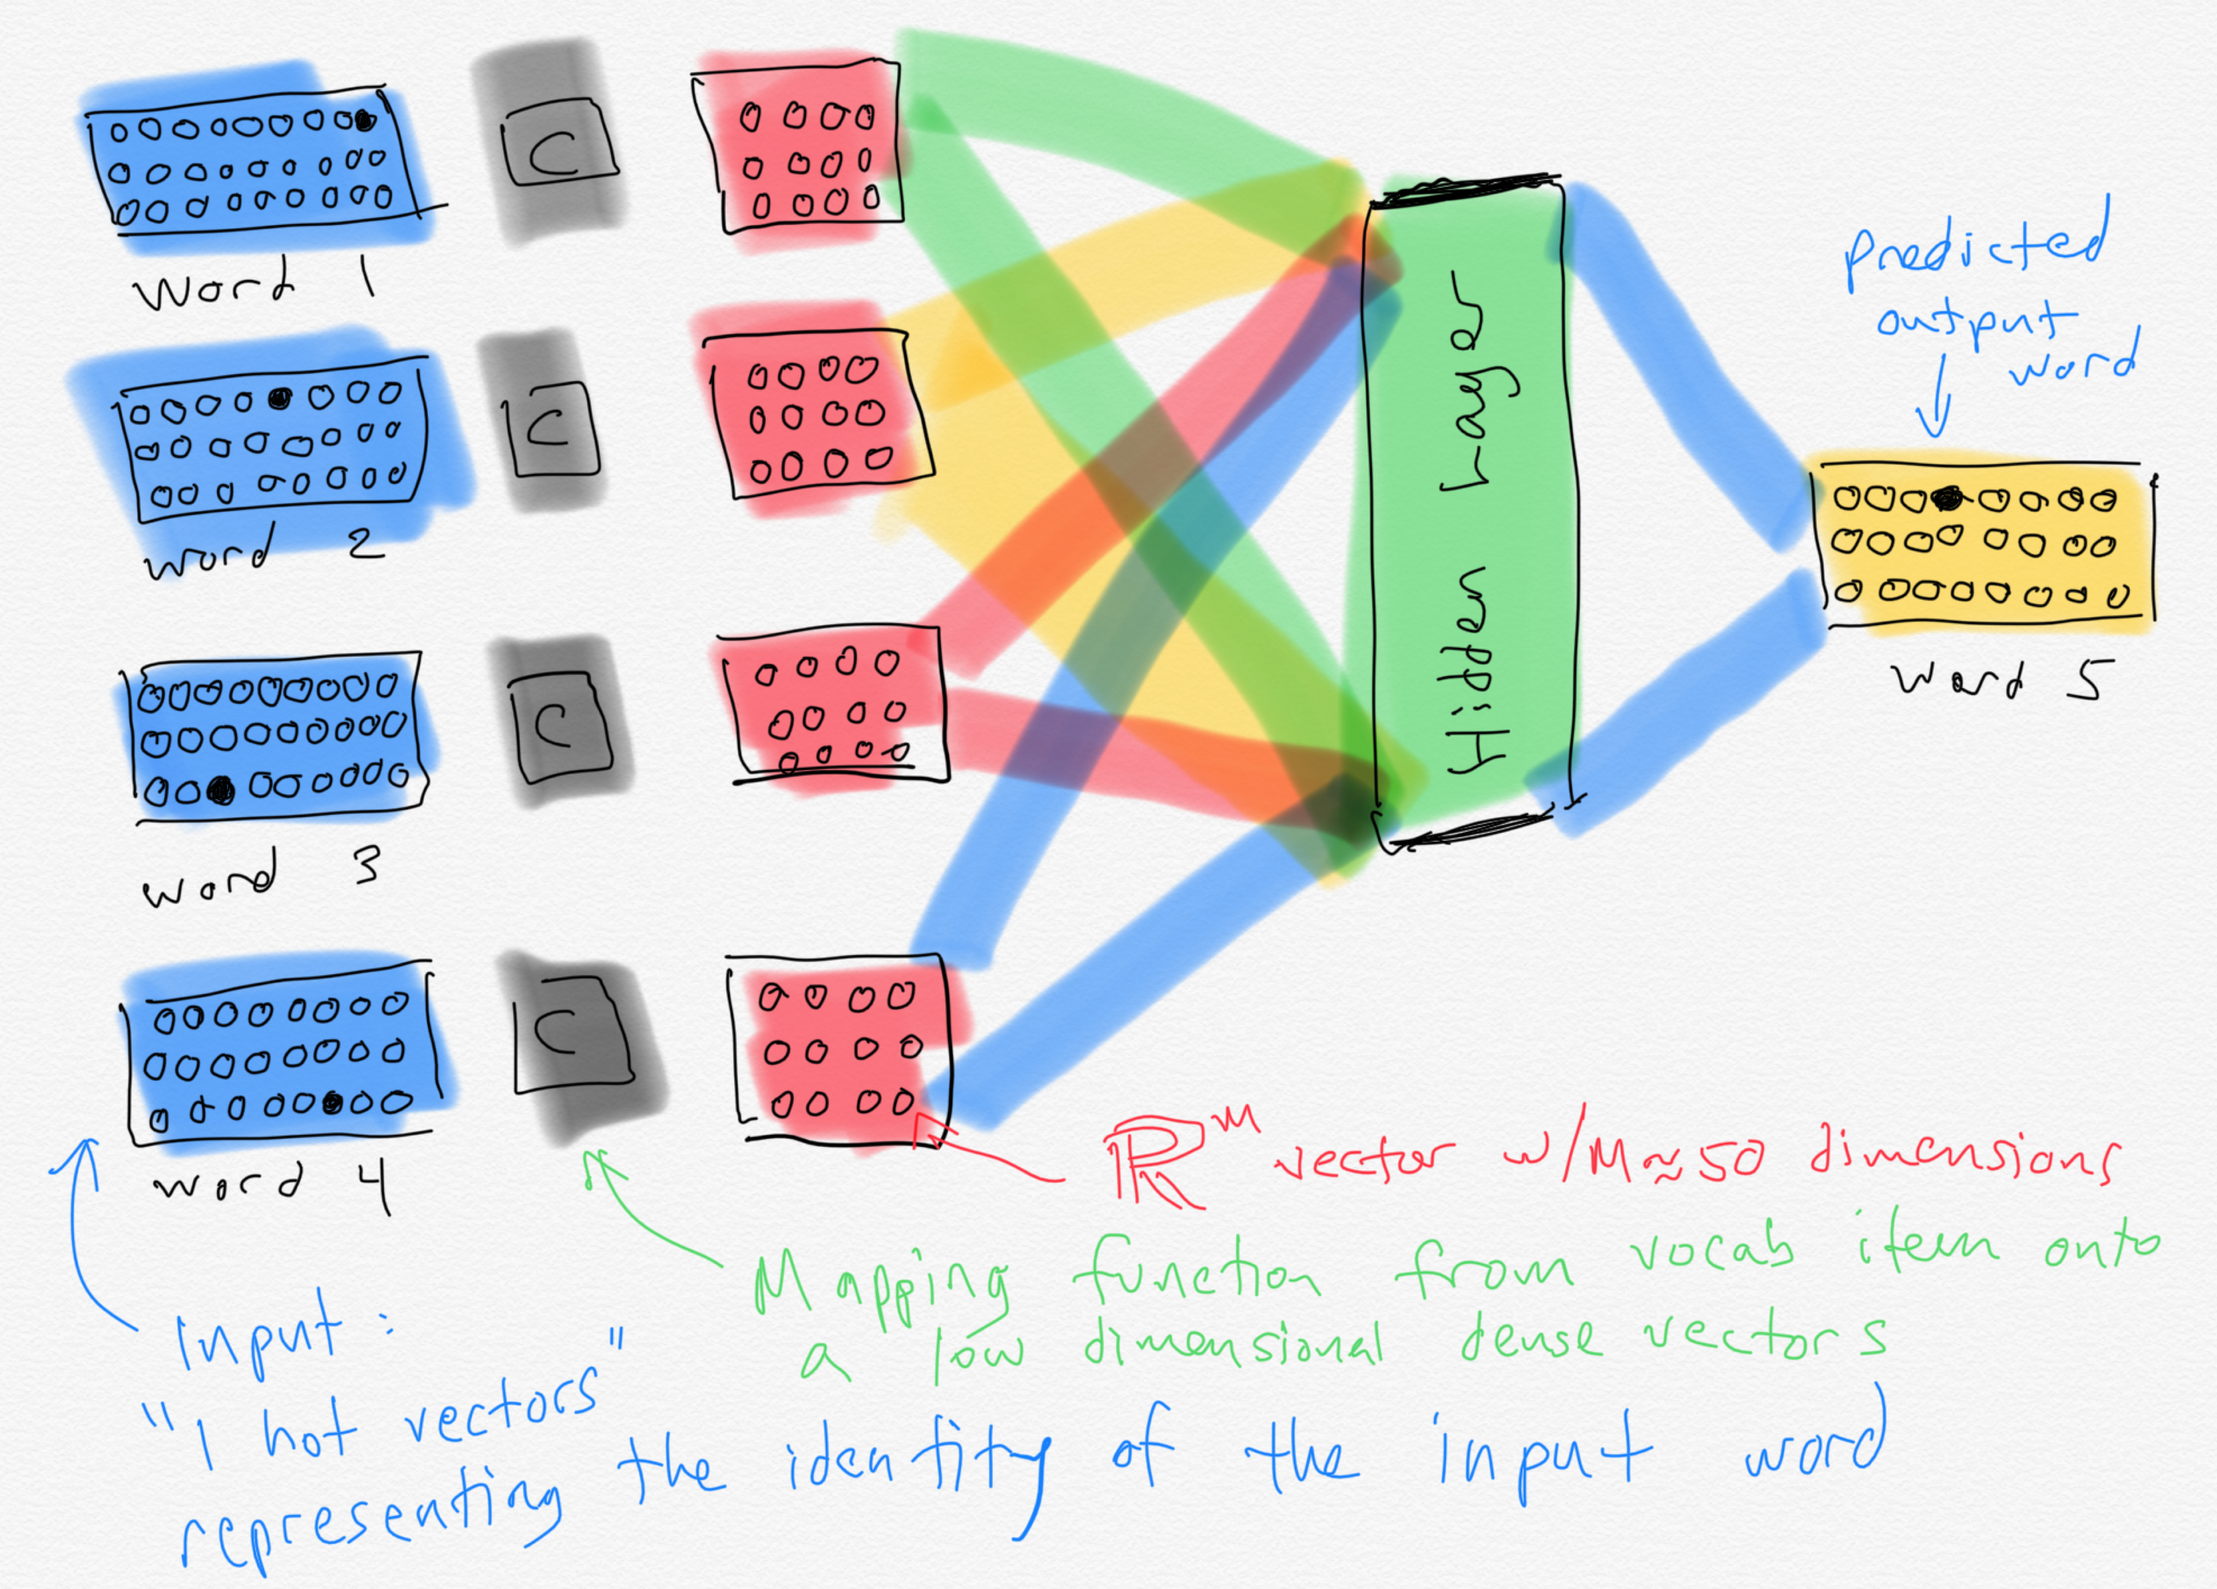

Slide 43
Word embeddings
When the ~50 dimensional vectors that result from training a neural LM are projected down to 2-dimensions, we see a lot of words that are intuitively similar to each other are close together.
Notes:
A by-product of training neural network-based language models are dense word embeddings, similar to word2vec.

Slide 44
Current state of the art neural LMs
ELMo
GPT
BERT
GPT-2
Notes:
ELMo: Embeddings from Language Models
GPT: Improving Language Understanding by Generative PreTraining
BERT: Bidirectional Encoder Representations from Transformers.

